Slide 1
PowerPoint Lunch n Learn
Mastering effective presentations for business impact
Venkat Raman

Slide 2

Introductions
Why am I doing this?
9+ years in consulting, most recently as a Partner at a large firm
Have made >1000 slides
>90% of them never saw the light of day (often scrapped in the first review)
Venkat Raman
Chief BizOps Officer and GM
(Recovering slide monkey)
But many (esp. the key messages) traveled far and wide into many rooms I wasn’t even in
Most importantly… this is an entirely learnable skill (I was AWFUL at slide-writing when I started)

Slide 3
Why PowerPoint matters (even though they’re annoying)?
Engages a diverse audience
Helps convey key messages in complex ideas in a structured and concise manner, to a diverse set of stakeholders, incl. leadership
Makes data actionable through insights
Allows you to transform raw data into clear insights through visuals like charts, graphs, and tables (vs. dashboards alone)
Forces brevity (especially with senior audiences)
Provides a way to communicate, especially in a limited attention society without patience for longer formats (E.g., memos)

Slide 4
Two parts to the presentation today
Effective storytelling
Structuring a slide deck
Creating the slide
Design best practices
Tips and tricks
Tools and shortcuts
Macros (Efficient Elements)
Charting (ThinkCell)
A
B

Slide 5
Topic A | Effective storytelling
Effective storytelling
A
Effective storytelling
Structuring a slide deck
Creating the slide
Design best practices
Tips and tricks
Tools and shortcuts
Macros (Efficient Elements)
Charting (ThinkCell)
A
B

Slide 6
“There is a real art in telling a story, in convincing people. Getting people to come on board with the points you are trying to get across is much more valuable than making sure that every talking point has been pushed out there.”
Effective storytelling
A
- Someone smarter than me

Slide 7
Structuring a slide deck | Why is story lining an essential first step for any presentation?
1) Structuring a slide deck
Effective storytelling
A
Grounds you in the dimensions of your story first before writing anything on a page
Helps you focus and prioritize your work
Forces you to synthesize and drive to the ‘so what’
Aids in the creation of your executive summary and elevator pitch

Slide 8
Key dimensions of the story you’re trying to tell
1) Structuring a slide deck
Effective storytelling
A
Remember…your story is (wwwaaaaaayyy) more important than the slide deck
Your Story
Why…
Are you telling the story
Who…
Is your audience
What…
Is your key message
How…
Can you communicate it?
Compel action
Provoke a reaction
Create a common viewpoint
Others?
Who is in the room?
Who is not in the room, but may see the deck?
What are their needs?
What is their perspective?
Answer the key question…FIRST
Frame in terms of ‘so-what’
Include only what your audience needs to know
How can you build credibility
Do we need data?
Can you involve your audience?
Your slide deck

Slide 9
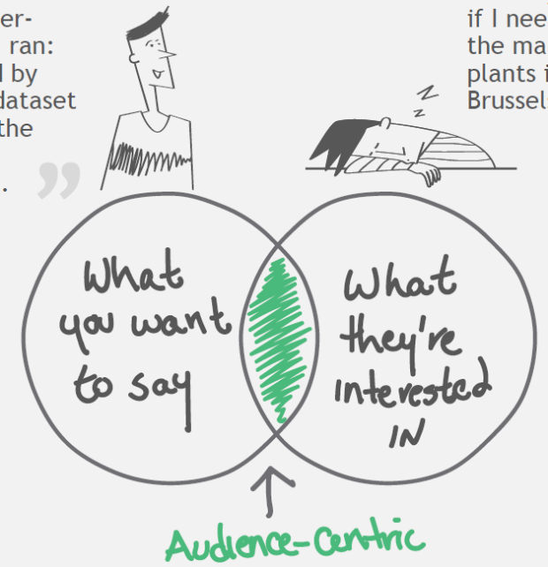
Bringing it to life | Pyramid principle elevates answer to the top
1) Structuring a slide deck
Effective storytelling
A
Answer always comes first – supporting ideas (arguments and evidence grouped together logically)
Let me tell you this super cool analysis I ran: First, I started by cleaning the dataset, reading three market reports, and applying the following assumptions…
Please just tell me if we need to enter the Workman’s comp LOB
01
Conclusion
02
Key arguments
03
Evidence
Entering workman’s comp increases revenue by $XXM, margins by XX%, but carries X, Y and Z regulatory considerations

Slide 10
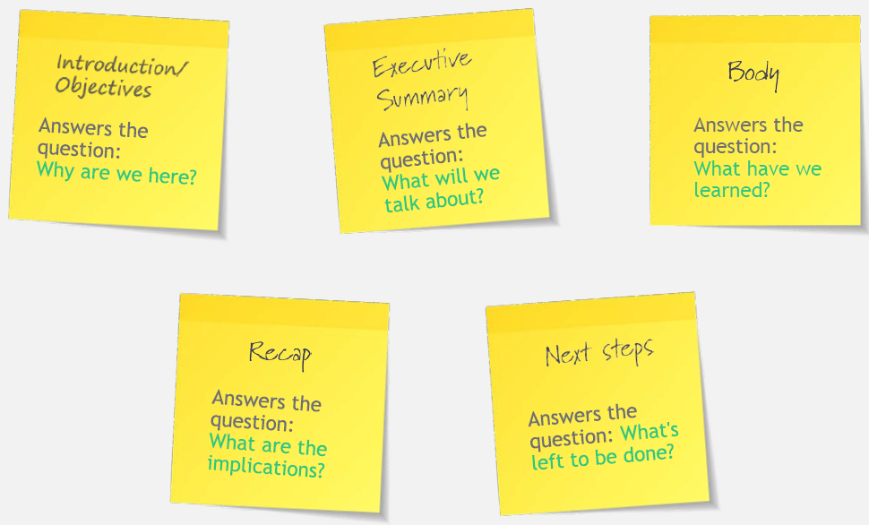
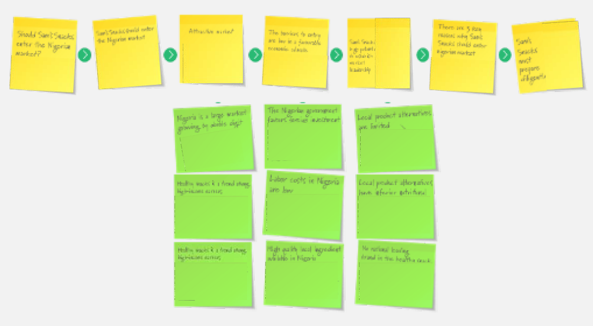
In practice, most presentations have ~5 parts
1) Structuring a slide deck
Effective storytelling
A
Start by writing out your key messages, and detail underneath as “slide titles” – recommend doing it as a group if applicable
Let’s put this into practice: Do any of you have a presentation you need to deliver?

Slide 11
What makes a great slide?
2) Creating the slide
Effective storytelling
A
Four complementary elements
Four characteristic features
A. Titles,
sub-titles
and
footnotes
C. Visuals
Clear / coherent | Reader “gets” the point you are trying to make Provide the right context for the data and information you are presenting Conclusion is logical and consistent with the data and sub bullet points on the page
Simple | One message per slide Everything on the slide serves the main point Avoid unnecessary buzzwords/technical jargon
Powerful | High-quality, compelling visuals that make messages ‘pop’ Clear links between the visual / data and the key message
Honest | Use transparent logic that makes obvious and consistent connections between data and conclusions Don’t misrepresent reality by selectively highlighting facts, mislabeling axes, etc.
B. Slide
layouts
and body
D. Language

Slide 12
Titles / Sub-titles | Help share most important message(s)
2A) Creating the slide: Titles, sub-titles and footnotes
Effective storytelling
A
Headlines dictate whether and how the reader will take in the rest of what you have to say
Slide titles should highlight the key message, match the body of the slide, and–when combined–tell your overall story
Good slide titles are concise and specific
Titles should provide the “so what"/actionable next step
Slide titles link the story together
Subtitles provide additional context to tell readers how to process the body of the slide… …BUT don’t use it to add on another / competing point to the main title and slide body

Slide 13
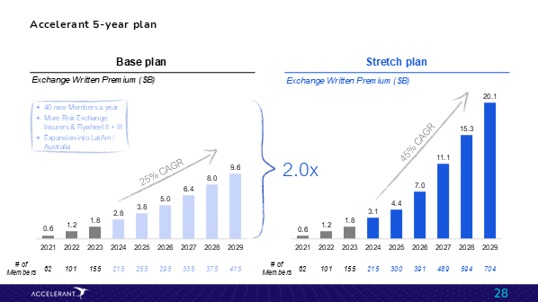
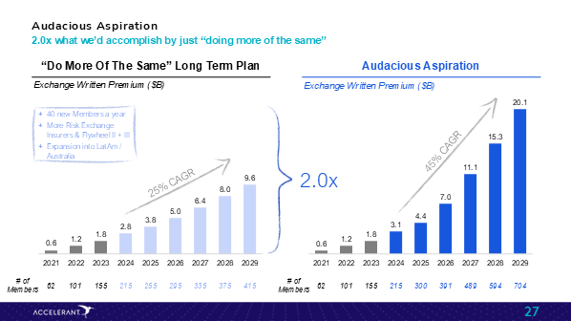
Exercise | Writing better titles
2A) Creating the slide: Titles, sub-titles and footnotes
Effective storytelling
A
What do you think about the title of this slide?
Is this title better?
2024

Slide 14
Double click | Slide titles link the story together
2A) Creating the slide: Titles, sub-titles and footnotes
Effective storytelling
A
Go from a set of descriptive titles…
…to a compelling story
Traditional insurance value chain
Traditional Insurance Distribution is Fragmented, Costly and Inflexible
Accelerant’s business model / flywheel
Accelerant is Re-platforming the Specialty Insurance Value Chain
Financial performance
200+ members, 65+ capital partners $2.5B+ GWP in only 6 years… and growing
Data, Technology and Analytics
Growth Underpinned by Proprietary and Differentiated Technology, Data and Analytics
Source: Project Swift Analyst Day deck

Slide 15
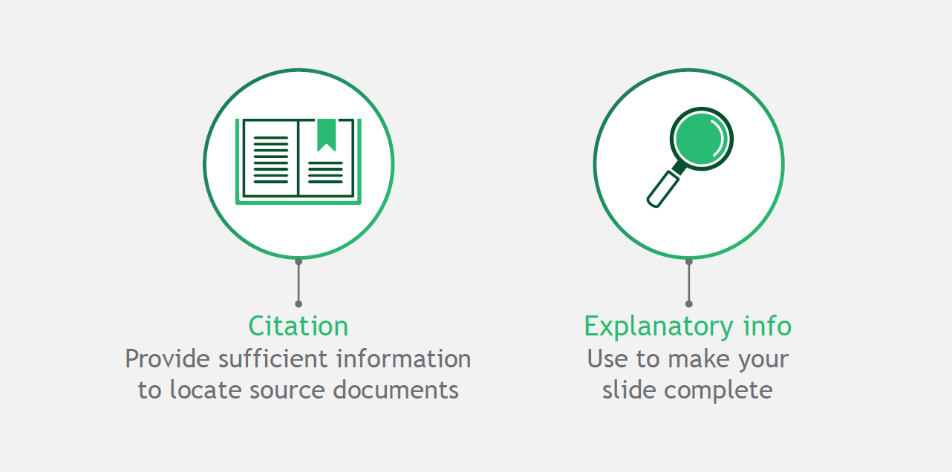
Footnotes | Provide citation and/or explanatory information
2A) Creating the slide: Titles, sub-titles and footnotes
Effective storytelling
A
Footnotes complete a slide - Use them especially when your deck will be read when you won’t be in the room
I personally prefer a 10-line footnote to none at all…
…but this may be less relevant for live presentation slides where voiceover will be present

Slide 16
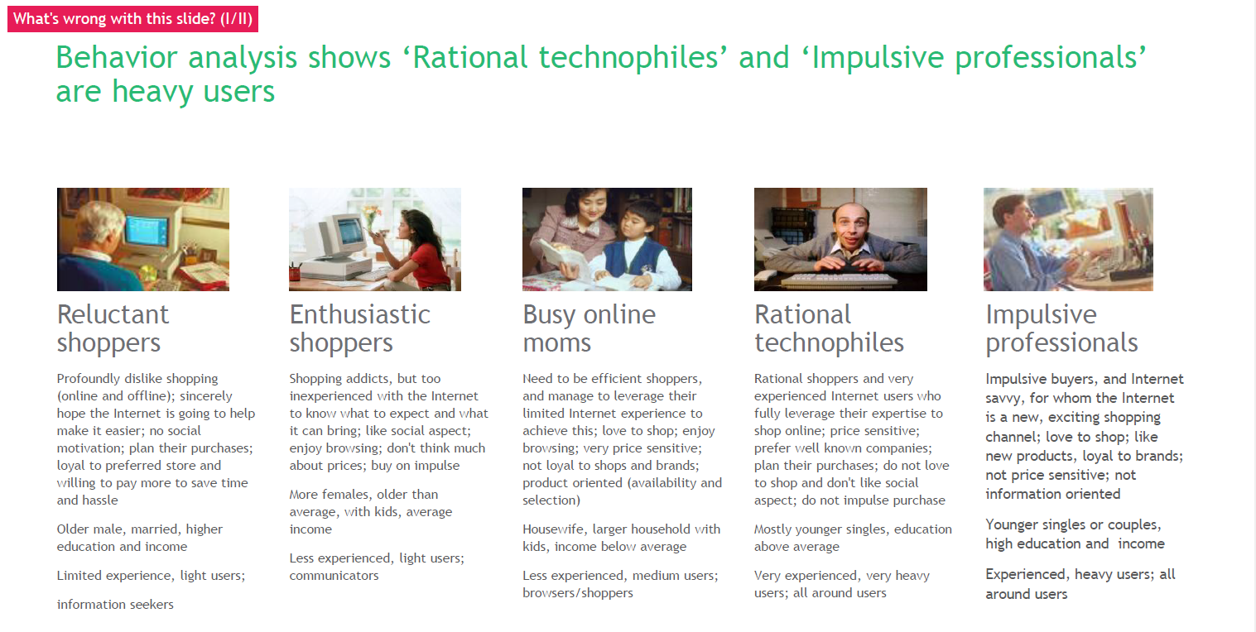
2B) Creating the slide: Slide body
Glance test – What is wrong with this slide?
Effective storytelling
A

Slide 17
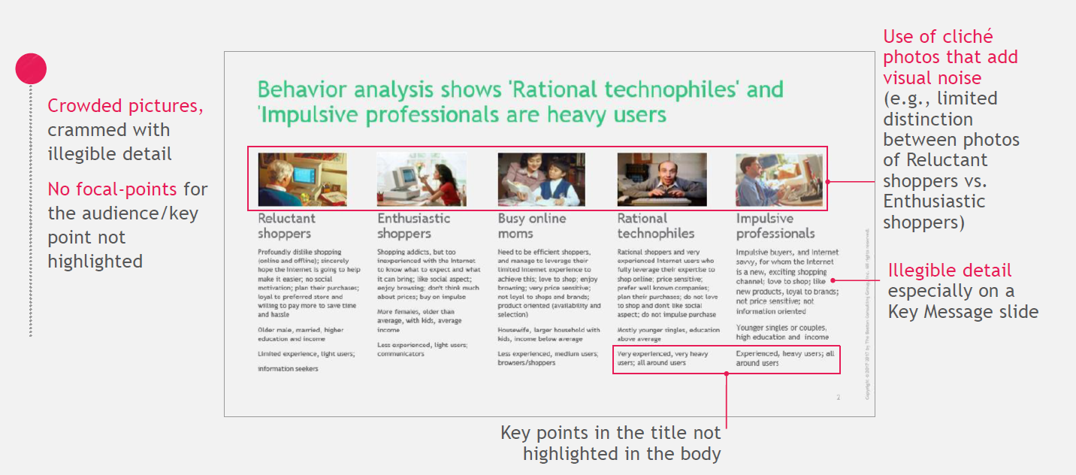
Things to avoid in the slide body
2B) Creating the slide: Slide body
Effective storytelling
A

Slide 18

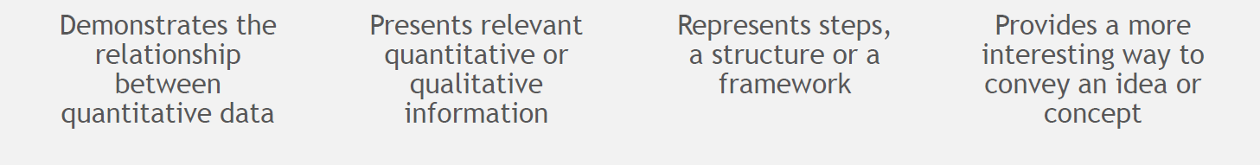
Visuals | Four common types of visuals in a deck
2C) Creating the slide: Visuals
Effective storytelling
A
Visuals help convey complex ideas and relationships in a simple and quick way to the reader

Slide 19
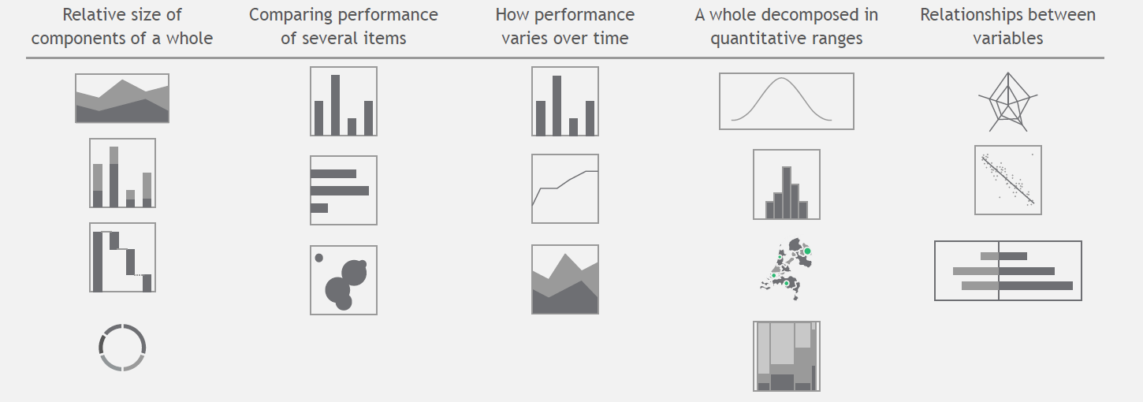
Charts | Help demonstrate different kinds of relationships
2C) Creating the slide: Visuals
Effective storytelling
A

Slide 20
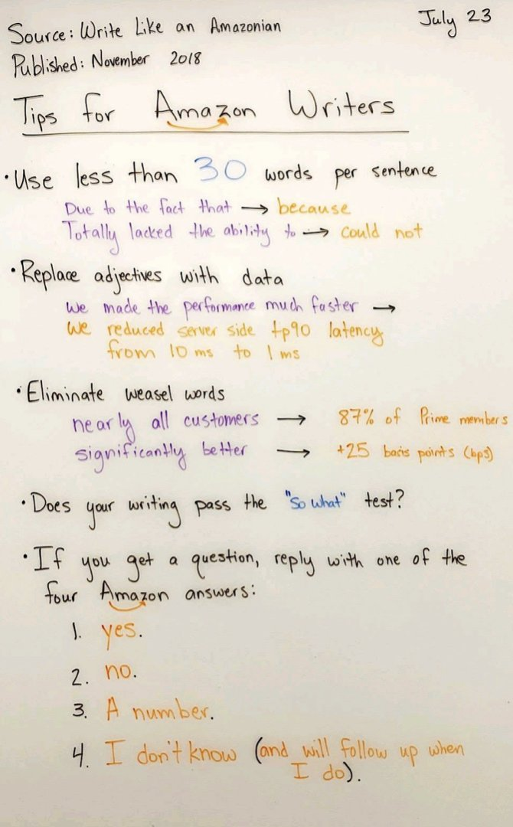
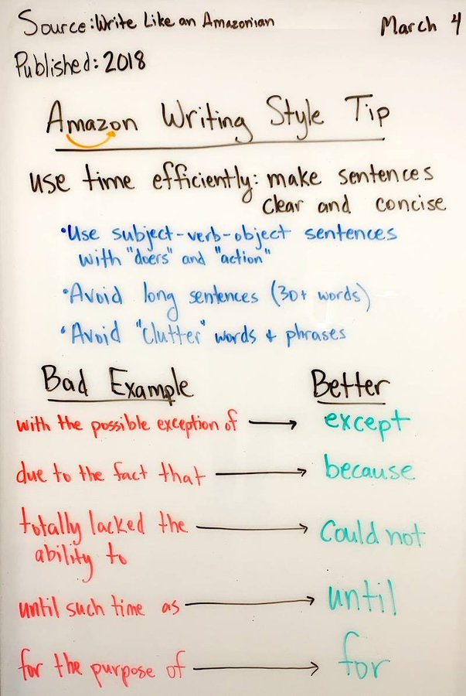
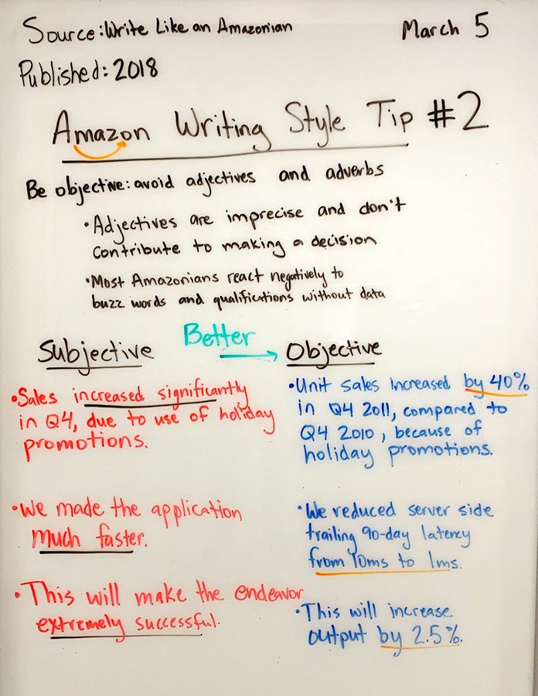
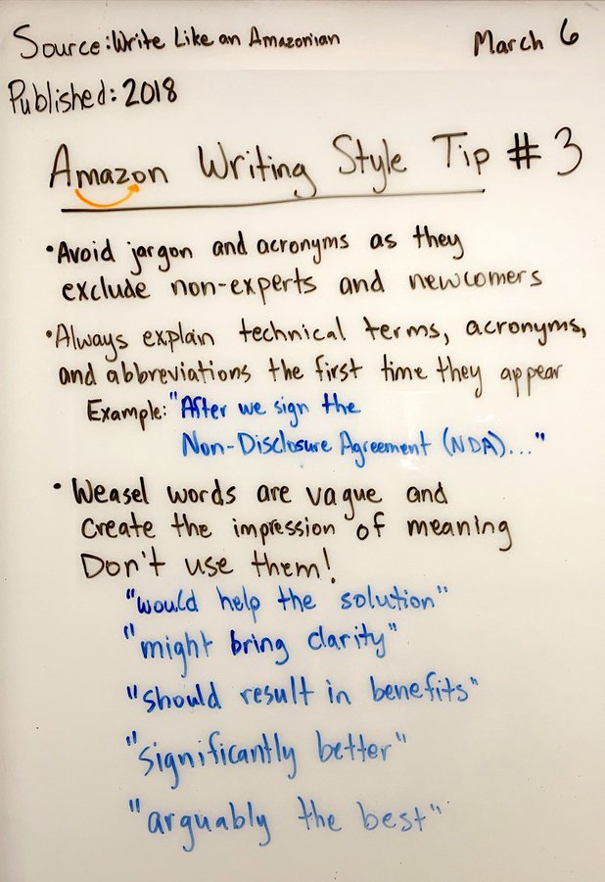
Language | Good writing clarifies thinking before communicating
2D) Creating the slide: Language
Effective storytelling
A
Generally follow Amazon’s writing principles for effective business writing

Slide 21
Draft – drain – refine to get to good slide language
2D) Creating the slide: Language
Effective storytelling
A
Draft
Drain
Refine
Get your story on paper
Take out unnecessary words
Make language more effective
We have designed a set of appealing offerings, which will likely acquire, deepen and penetrate customer relationship effectively
Acquire: Business solution with immediate value to be provided to clients and improve acquisition success rate effectively
Deepening: To strengthen digital platform and appealing insurance products to deepen relationship
Penetration: Ensure holistic planning and investment expertise for revenue fee generation from clients
We have designed a set of appealing offerings, which will likely to build acquire, deepen and penetrate customer relationship effectively
Acquire: Business solution with immediate value to be provided to clients and improve acquisition success rate effectively
Deepening: To strengthen digital platform and appealing insurance products to deepen relationship
Penetration: Ensure holistic planning and investment expertise for revenue fee generation from clients
Three appealing offerings to build customer relationship effectively
Acquire: Solutions with immediate value to improve success rate
Deepen: Strengthened digital platform and insurance products
Penetrate: Holistic planning and investment expertise for fee generation

Slide 22
Design principles | 5 critical principles create harmony in a deck
3) Design principles
Effective storytelling
A
Contrast
Whitespace
Hierarchy
Eye flow
Unity

Slide 23
Detail | Design principles to create slide harmony
3) Design principles
Effective storytelling
A
Contrast
Whitespace
Hierarchy
Eye flow
Unity
Our eyes are drawn to what is different, and quickly identify things that stand out from their environment
In design, contrast helps focus attention, and set hierarchy
E.g., Section title vs. header title
Whitespace is negative space around key content
Avoid filling up a slide with additional content fighting for attention
Utilizing a healthy amount of white space creates higher perceived value
Good hierarchy visually organizes elements, helping viewers identify key information quickly and process it faster.
Use contrast (size, shape, color, and spacing) to establish hierarchy
E.g., header font size >= body font size
Eye flow refers to how your eye travels across a page
Place elements in a way that directs your audience’s focus in a slide to important points quickly
E.g., Number balls, arrows indicating flow of ideas on a page
Unity makes a presentation feel cohesive, as if created by one person, with all ideas part of a single message
E.g., achieve unity with consistent design, fonts, colors, repetition and placement – without any deviations

Slide 24
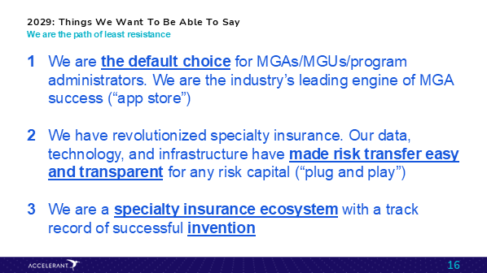
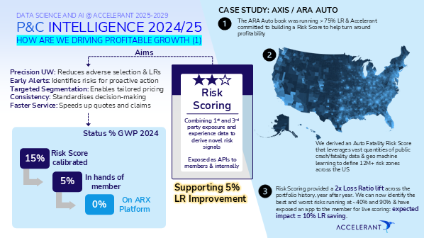
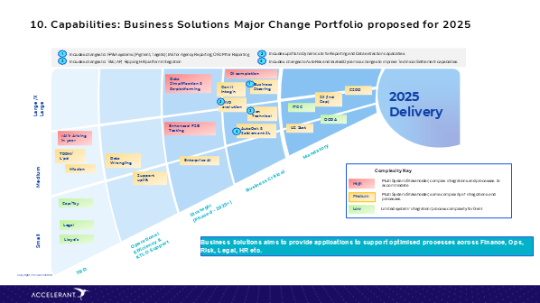
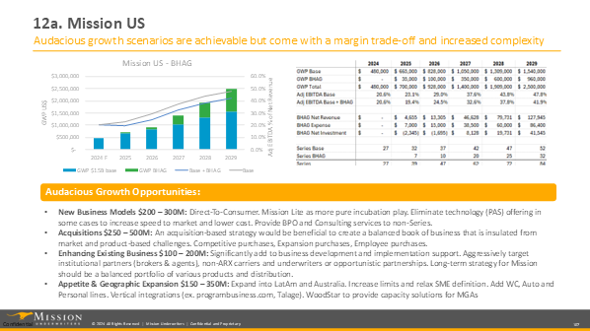
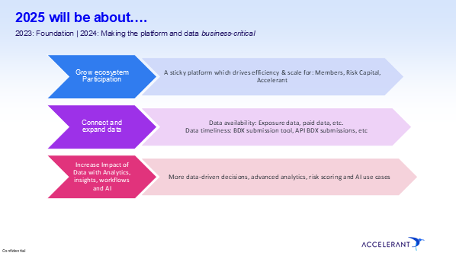
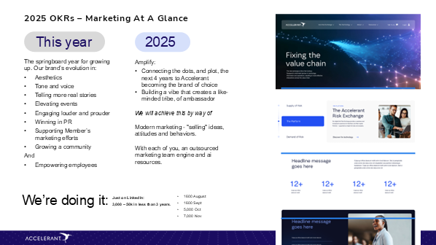
Double click | Unity in a presentation
3) Design principles
Effective storytelling
A
All these slides are from the exact same presentation – What do you notice?
Tips to drive unity in a deck
Consistently apply the brand elements (font size, primary / secondary colors, etc.)
Do not switch between ‘Slide Masters’ in a deck
Use the Slide layouts (Right click + layout) which are the pre-made templates for each master, to create your slides

Slide 25
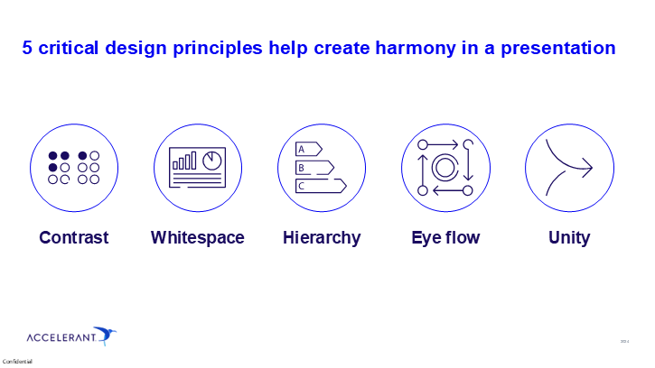
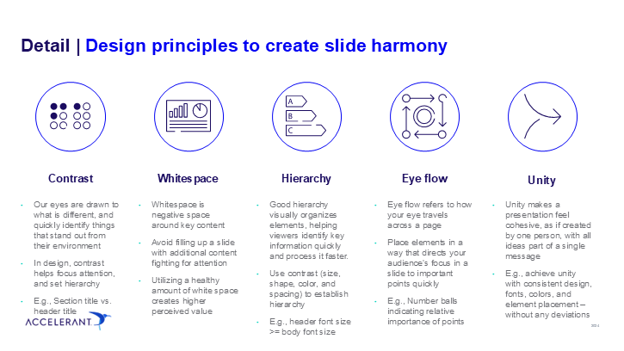
Visually introduce ‘key messages’…
3) Design principles
Effective storytelling
A
…before adding necessary ‘detail’ slides
This tip is great for creating slides like Product roadmaps, communicating change initiatives, project plans, etc.
Notes:
The names are pretty self explanatory – Key Message slides highlight the most important takeaways and conclusions from our work, while Detail slides provide all of the documentation.
KM slides are simpler, they have less information density – the goal is that those takeaways can be absorbed quickly, then focus can be brought back to the presenter during a live presentation.
On the other hand there are cases in which more information is needed, which is why we also have the Detail slide format. This format is not meant to be the bulk of a presentation- it can be used as pre-read or leave behind material, or brought up to address detailed questions during a live presentation.

Slide 26
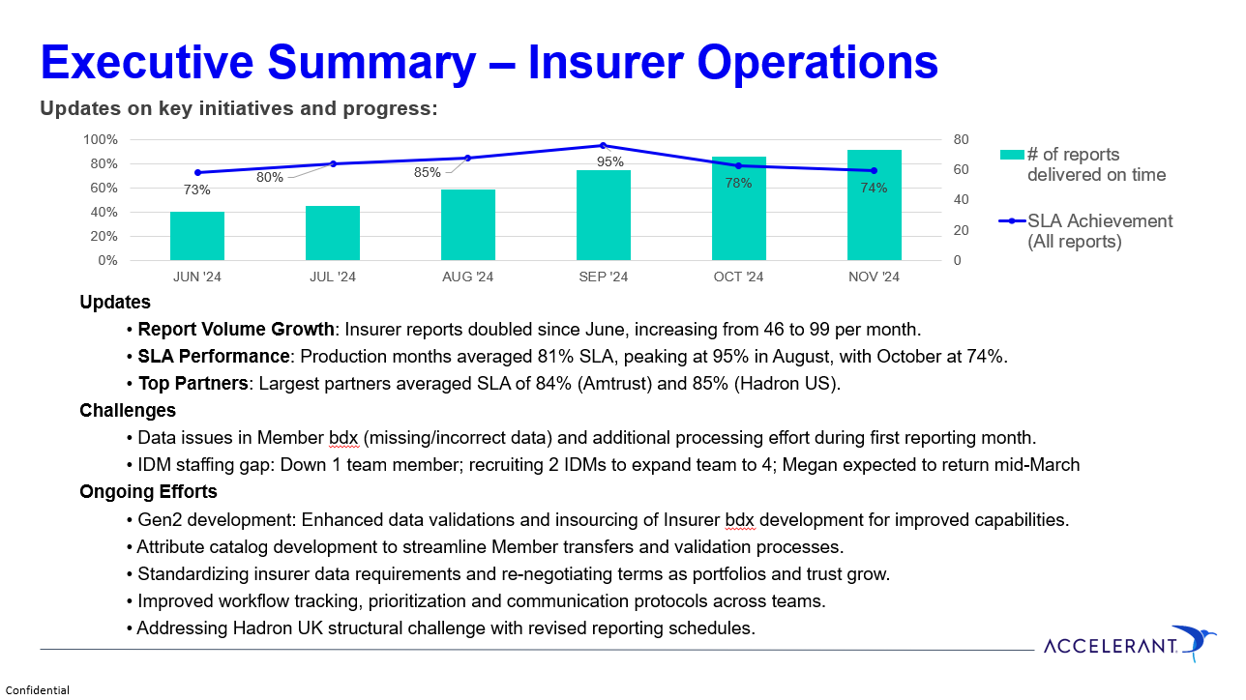
Glance test – How could you improve this slide?
Effective storytelling
A
Subtitle does not add incremental information to what’s in the title / body
Missing title for the chart, axes
No values on each bar
No context on why the graph starts Jun ’24 (footnote?)
Redundant information between data in the chart and body of the slide (some data not traceable e.g., 99 reports)
Visual cues could help differentiate challenges that may need solution from audience vs. updates
Parallel sentence construction could enhance readability – First bullet has a ‘:’ before sentence while others don’t
Any others???
Source: Credit to Insurer Operations team for permissions to share slide

Slide 27


Executive Summary – Insurer Operations
Effective storytelling
A
Delivered >2x reports in Nov vs. Jun-24 with ~81% avg. SLA met
Nov-24 SLA ~74% (~6 ppt lower vs. avg) driven by data / staffing issues; 5 ongoing efforts to drive improvement
# of insurer reports submitted
% SLA met
Challenges
Data issues: Missing/incorrect data in Member bdx and additional processing effort during first reporting month
IDM staffing: Down 1 team member; recruiting 2 IDMs to expand team to 4; Megan returning mid-March
+2x
100
95%
99
Peak SLA
88
63
55
Ongoing efforts
Gen2 rollout: Enhanced data validations and insourcing of Insurer bdx development for improved capabilities
Attribute catalog: Development of catalog to streamline Member transfers and validation processes
New standards: Standardized insurer data requirements and re-negotiating terms as portfolios and trust grow
Stronger processes: Improved workflow tracking, prioritization and communication protocols across teams
Hadron UK reporting: Addressing Hadron UK structural challenge with revised reporting schedules
44
45
0
Jun-24
Jul-24
Aug-24
Sep-24
Oct-24
Nov-24
SLA achievement %
Reports delivered on time
Reports delayed
Avg. SLA % of largest partners
84%
85%
Month refers to production period
Reporting period starting from Jun-2024 due to XXX
Source: Insurer Monthly Bordereau Reporting - Power BI
Notes:
Adam
December 2024
ASIC and ANIC QS. 50% + of the business. There are no business exceptions.
ASIC and ANIC LPTs. TBD on the amount of business. The goal is to create "fronting companies" out of ASIC and ANIC, thereby sweeping up all NWP
Woodstar Reciprocal Exchange: 25 direct policies
January 2025
ASIC and ANIC QS. 50% + of the business remains in place. There are no business exceptions.
Woodstar Specialty (Non-admitted) Direct Writings begin to occur

Slide 28
Topic 2 | Tips and tricks
Tips and tricks
B
Effective storytelling
Story lining a slide deck
Creating the slide
Design best practices
Tips and tricks
Tools and shortcuts
Macros (Efficient Elements)
Charting (ThinkCell)
A
B

Slide 29
Do you like sleep?
Tips and tricks
B
If you like sleep, then you've come to the right place…

Slide 30
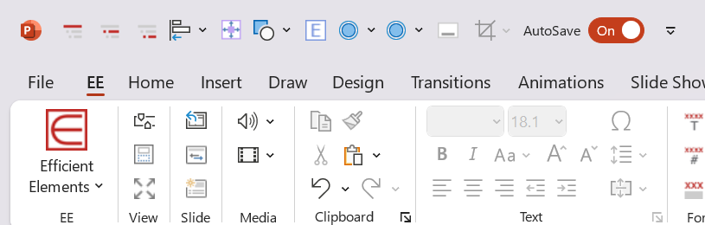


Three categories of tips and tricks
Tips and tricks
B
Shortcuts
Quick Access Toolbar
Slide checklists
Macros
Efficient Elements
Charting
Charting Principles
ThinkCell

Slide 31
1) Tools and shortcuts
Tips and tricks
B
Shortcuts themselves don't directly make you better at the job…
… but free up your time to focus on the 'thinking' part of the job, that does make you better at the job

Slide 32
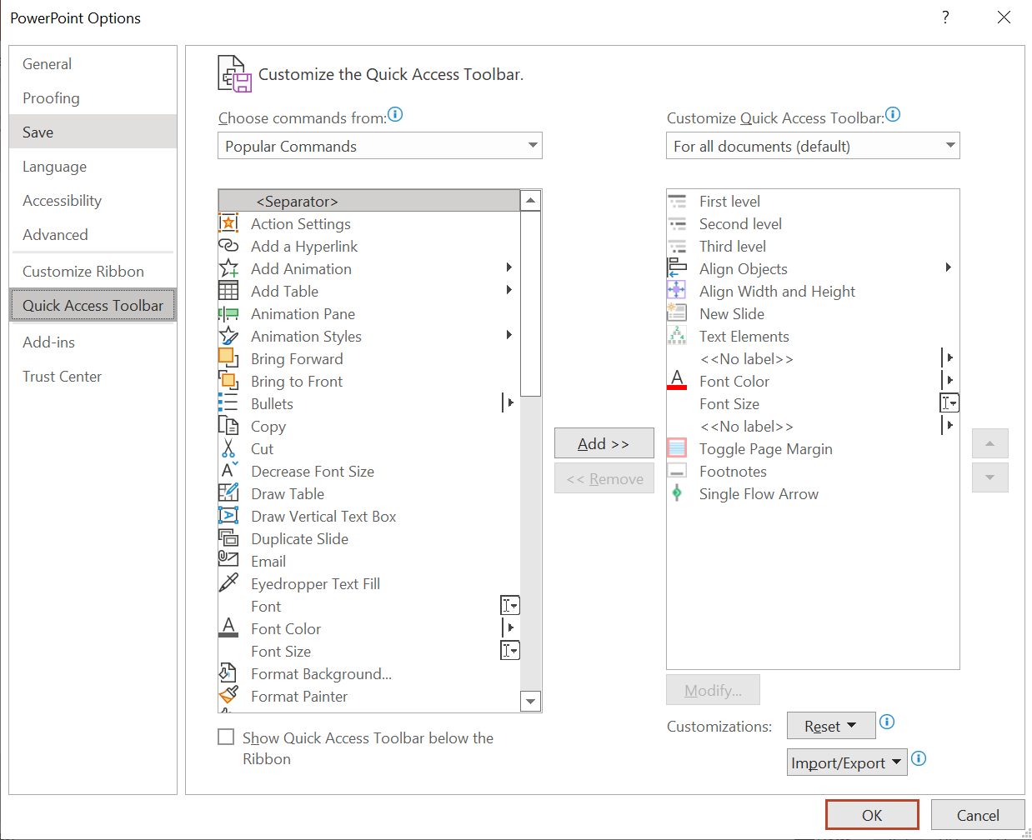
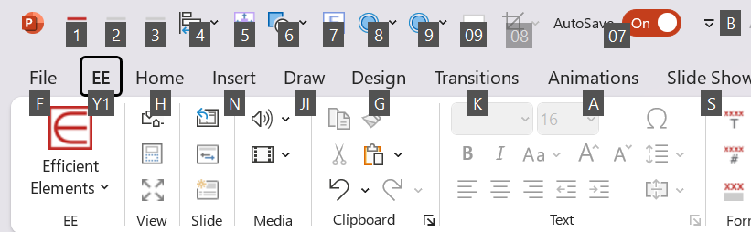
Quick Access Toolbar (QAT) | Customize the QAT for your needs
1) Tools and shortcuts
Tips and tricks
B
Located just above the ribbon, the QAT lets you access common commands no matter which tab is selected
1
3
2
4
Open "File" then "Options
Click "Quick Access Toolbar"
Search for the command
Click "Add>>"
1
2
Once added, it only takes 2 keystrokes to execute the command (e.g., ALT + 1)
3
4

Slide 33
How to add and a list of "my" QAT commands; you know what you use the most, do what's right for you
1) Tools and shortcuts
Tips and tricks
B
# | Commands | Description/Example
1 | First level | Changes text to level 1 bullet
2 | Second level | Changes text to level 2 bullet
3 | Third level | Changes text to level 3 bullet
4 | Align objects | Aligns selected objects to the left, right, center, etc.
5 | Exact size | Matches width and height of separate objects
6 | New Shape | Inserts different kinds of shapes
7 | Elements | Home for text and visual elements
8 | Comment Stickie | Creates a comment stickie
9 | Status Stickie | Creates a status stickie
09 | Footnote | Add footnote to slide
08 | Crop to shape | Crop pictures to specific shapes (E.g., circles)
07 | Autosave | Toggle auto save on/off

Slide 34
Basic shortcuts | Learn the critical PPT native shortcuts
1) Tools and shortcuts
Tips and tricks
B
Category | Action | Shortcut
General | New Presentation | Ctrl + N
 | Open Presentation | Ctrl + O
 | Save | Ctrl + S
 | Print | Ctrl + P
 | Undo | Ctrl + Z
 | Redo | Ctrl + Y
Formatting | Bold | Ctrl + B
 | Italic | Ctrl + I
 | Underline | Ctrl + U
 | Increase Font Size | Ctrl + Shift + >
 | Decrease Font Size | Ctrl + Shift + <
Slide Show | Start from Beginning | F5
 | Start from Current Slide | Shift + F5
 | End Slide Show | Esc
 | Next Slide | N, Right Arrow
 | Previous Slide | P, Left Arrow
Navigation | Switch Between Presentations | Ctrl + F6
 | Next Pane | F6
 | Previous Pane | Shift + F6
 | Move to Next Placeholder | Ctrl + Enter
Slide Management | Duplicate Slide | Ctrl + D
 | Delete Slide | Delete
 | New Slide | Ctrl + M
 | Move Slide Up | Ctrl + Shift + Up
 | Move Slide Down | Ctrl + Shift + Down
Editing | Copy | Ctrl + C
 | Paste | Ctrl + V
 | Cut | Ctrl + X
 | Select All | Ctrl + A
 | Find | Ctrl + F
 | Replace | Ctrl + H
Views | Normal View | Alt + Shift + 1
 | Slide Sorter View | Alt + Shift + 2
 | Reading View | Alt + Shift + 3
Category | Action | Shortcut
Views | Slide Show View | Alt + Shift + 4
 | Zoom In | Alt + Shift + Plus
 | Zoom Out | Alt + Shift + Minus
 | Fit slide to screen | Alt + W + F
Objects | Group Objects | Ctrl + G
 | Ungroup Objects | Ctrl + Shift + G
 | Bring to Front | Ctrl + Shift + F
 | Send to Back | Ctrl + Shift + B
Other things you definitely do often | Spell Check | F7
 | Insert Hyperlink | Ctrl + K
 | Insert New Comment | Alt + N, M
 | Delete Comment | Alt + R, D
 | Activate Ribbon | Alt or F10
 | Hide/Show Ribbon | Ctrl + F1
 | Help | F1
 | Screenshot | Alt + N, S
 | Duplicate Object | Ctrl + Shift + D
 | Insert Table | Alt + N, T
 | Move bullets up | Alt + Shift + Up
 | Move bullets down | Alt + Shift + Down
 | Open shape options | Shift + F10 + O
 | Merge cells in a table | Alt + J + L + M
 | Align text left | Alt + H + A + L
 | Align text right | Alt + H + A + R
 | Align text center | Alt + H + A + C
 | Align text top | Alt + H + A + T + T
 | Align text middle | Alt + H + A + T + M
 | Align text bottom | Alt + H + A + T + B
 | Right click | Shift + F10
 | Select shape once already in it | Esc
 | Move around between shapes on a page | Alt + Arrows
 | Format painter copy | Ctrl + Shift + C
 | Format painter paste | Ctrl + Shift + V
 | Duplicate and drop item (freely) | Control + drag
 | Duplicate and drop item (horizontal or vertical) | Control + Shift + drag

Slide 35
Slide checklist | Before circulating a deck to leadership or your team, ask yourself, "Have I…"
1) Tools and shortcuts
Tips and tricks
B
Story Telling | Read through my slide titles from front to back to confirm my story flows logically? Tip: On EE task pane, select "More" under "Expert Tools". Then, select "Copy Summary to Clipboard" to copy all slide titles into a summary Included a context or executive summary page? Included an agenda or table of contents page? Included a next steps page? Included an action title on the slide? Is there a clear so what? (or is it a filler slide) Indicated appropriate 'stamps' on the page e.g., when slides are work in progress, or is an update to a previously seen slide? Checked if there are places where trackers or framework pages are needed to give broader context? Checked if there are pages in the storyline that would benefit from additional detail with an Appendix slide? Challenged myself to increase font size to simplify messages on the page? Tip: When you finish writing a text heavy page, try raising the font size by 2-4 pts. to cut word count
Formatting | Used standard grid format, and ensured I am not in the "no-fly zone? Checked that objects are spaced evenly and aligned? Used one consistent font throughout the deck? Used only colors from my Efficient Elements task pane? Used correct slide deck format? (see section 3 of deck for how to confirm this on the BCG HOME Ribbon) Added navigation trackers to the top-right corner?
Sense Checks | Labelled all my graphs, tables, and images? Included legends where required? Indicated units where required? (e.g., millions, dollars, etc.) Included footnotes when referencing data sources? Used ranges when making many assumptions? (avoid false precision) Removed significant digits? (avoid false precision) Confirmed my numbers "foot" across slides? (e.g., are the totals at the bottoms of my tables correct? If I update a number, have I updated it throughout the entire deck?) Used a number in a slide title that is not elsewhere on the slide? (avoid doing this) Included column headers and "totals" row at the bottom of tables with numbers?

Slide 36

2) Efficient elements
Tips and tricks
B
Add-in for PowerPoint helping create professional presentations in less time with consistent branding
Executes editing and formatting quicker with the Efficient Elements
What is Efficient Elements for presentations?
Provides extensive library of pre-made elements including charts, diagrams, and boxes
Offers hundreds of icons, flags, and illustrations, and customization of layouts

Slide 37
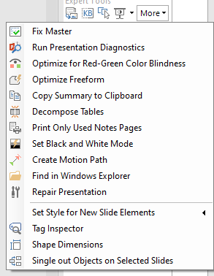





A list of Efficient Elements I use most frequently
2) Efficient elements
Tips and tricks
B
# | Efficient element | Description/ Use Case
1 | Save selected slides | Helpful for saving select slides as a distinct presentation
2 | Email selected slides "Ctrl + Shift + E" | Helpful for sending select slides quickly
3 | Agenda Wizard | A quick and efficient way to create agenda slides
4 | Align "Ctrl + Alt +" (Left, Center, Right, Top, Middle, Bottom) | Align object(s) to the left, center, right, etc. of the last object selected
5 | Distribute horizontally/vertically | Evenly space out selected shapes
6 | Align in Table "Ctrl + Shift + T" | Align icons/images to a cell in a table
7 | Swap "Ctrl + Alt +" (horizontally, vertically or direct Swap) | Useful when reordering or replacing objects of the same dimensions
8 | Align "Ctrl + Alt +" Width and/or Height | Matches the size of the last object selected
9 | Magic Resizer "Ctrl + Shift + Z" | Allows you to resize a group of objects without distorting them
10 | Insert select slides as pictures | Useful for proposals/decks where you want to show illustrative output
11 | Select similar types "Ctrl + Shift + L" | After clicking one object (e.g., a circle) you can select all the other similar objects – great for aligning and formatting
12 | Set Style for New Slide Elements | Helpful when the right color palette isn't showing because you copy pasted slides from other decks
13 | Show / hide Color bar “Alt + Shift + C" | Allows you to select colors from the approved theme of colors
1
2
3
12
4
13
5
6
7
8
9
10
11
Most used (and loved)

Slide 38
Charting | Objectives and tactics (I/III)
3) Charting
Tips and tricks
B
Goals
Tactics
Data integrity
No visual distortion or misrepresentation of data
Normalize data series
Standardize units of measure
Deflate nominal currencies (esp. over long periods of time)
Ensure graphic impressions are proportional to underlying data
Zero-base Y-axes
Use consistent axis increments (and scales)
Scale bubble area (not radius) to data magnitude
Avoid “cartoon” legends
Validate/investigate/annotate outliers and anomalies
Accurately, completely footnote (N=, exact source, source date, data limitations, methodology)
Graphic effect
Data effect
1.0

Slide 39
Charting | Objectives and tactics (II/III)
3) Charting
Tips and tricks
B
Goals
Tactics
Data integrity
Normalize data series
Standardize units of measure
Deflate nominal currencies (esp. over long periods of time)
Ensure graphic impressions are proportional to underlying data
Zero-base Y-axes
Use consistent axis increments (and scales)
Scale bubble area (not radius) to data magnitude
Avoid “cartoon” legends
Validate/investigate/annotate outliers and anomalies
Accurately, completely footnote (N=, exact source, source date, data limitations, methodology)
Graphic effect
Data effect
1.0
Data density
Maximize the density of information conveyed without overloading the slide
Condense several displays onto one slide
Multipanel slides (multiple logically related displays)
“Small multiples” (repeated small displays with identical axes)
Use direct labels (not separate boxed legends)
Maximize graphic size/area, eliminate unnecessary framing boxes
Blend quantitative and qualitative
e.g., annotate graphic with text boxes, mix quotes and hard data
Quantify visual impressions
e.g., add R², CAGR, scale slope, standard deviation
Add comparative data (e.g., average, hurdle rate, market index line)
Add more data points (if available)
Longer time series, better disaggregation
Data ink
Total ink
1.0

Slide 40
Charting | Objectives and tactics (III/III)
3) Charting
Tips and tricks
B
Goals
Tactics
1. Data integrity
Normalize data series
Standardize units of measure
Deflate nominal currencies (esp. over long periods of time)
Ensure graphic impressions are proportional to underlying data
Zero-base Y-axes
Use consistent axis increments (and scales)
Scale bubble area (not radius) to data magnitude
Avoid “cartoon” legends
Validate/investigate/annotate outliers and anomalies
Accurately, completely footnote (N=, exact source, source date, data limitations, methodology)
Graphic effect
Data effect
1.0
Data density
Condense several displays onto one slide
Multipanel slides (multiple logically related displays)
“Small multiples” (repeated small displays with identical axes)
Use direct labels (not separate boxed legends)
Maximize graphic size/area, eliminate unnecessary framing boxes
Blend quantitative and qualitative
e.g., annotate graphic with text boxes, mix quotes and hard data
Quantify visual impressions
e.g., add R², CAGR, scale slope, standard deviation
Add comparative data (e.g., average, hurdle rate, market index line)
Add more data points (if available)
Longer time series, better disaggregation
Data ink
Total ink
1.0
Message coherence
All critical insights immediately apparent
Chose design which emphasizes important relationships
Focus your reader’s attention on key messages
Highlight key data with shading, arrows, boxes
Order lists and groups
Eliminate unnecessary or distracting detail
Obvious messages
Important messages
1.0

Slide 41
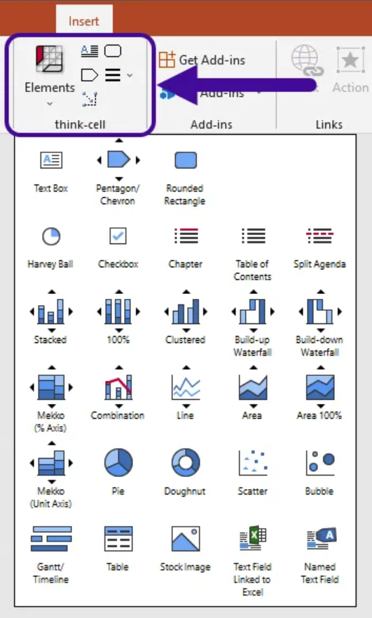
Thinkcell makes creating impressive charts much easier
3) Charting
Tips and tricks
B
Key benefits…
Chart Creation
40+ chart types including waterfall, Gantt, and process flows
Automatic data-driven annotations and calculations
One-click addition of labels, percentages, and CAGR arrows
Smart Integration
Seamless Microsoft Office integration
Excel data linking for automated updates
Direct data capture from PDFs and websites
For an overview of Thinkcell: Click here

Slide 42













Matrix of Think-Cell graphics and use cases
Common match
Usual best viz for U.C.
Share (%) |  | X |  |  | X | X |  | X |  |  |  | Never use pie charts…ever
Value (extent) | X |  | X | X | X | X | X |  | X |  | X
Distribution | X |  |  | X |  |  |  |  |  | X
Change (inc. over time) | X | X | X | X |  | X | X |  | X
Correlation |  |  |  | X |  |  |  |  | X | X | X
Comparison | X | X | X |  | X |  |  |  | X | X | X
Accumulation | X |  | X |  |  | X | X |  | X
Matrix (4 elem.) |  |  |  |  |  |  |  |  |  |  | X

Slide 43
Other parting tips…
Tips and tricks
B
There are 3 types of slides –
Slides with unclear insights / too much detail
Clear slides that shows analysis and its insights elegantly – one key takeaway per slide that you "get" in <10 seconds of reading
Pretty slides that make you question your career
Aim for #2– Avoid #1 always; #3 is awesome but not an expectation and can be used selectively if it's high priority external content
Think in key messages first and then the supporting details
Build your slide library
Use tables over text boxes wherever possible
Always (ALWAYS) stick to the brand guidelines
Utilize the full potential of the Quick Access toolbar tailored to your needs
Increase information to ink ratio on every page
Never use pie charts (ever)
Use picture effects like shadows to create depth perception
Don’t overdo images and icons - Too many icons can overpower content and confuse your audience (Avoid using >6-8 icons on any one slide)
Use cell spacing in a table to add whitespace and breathing room
Simplify your graphs, use contrasting colors, & make them as large as possible
Be consistent with your colors. E.g., if you have 2 charts on a page, or a chart and a table/text related to the chart, make sure colors match
Never repeat the same colors in the same graphs
Notes:
Disadvantages of pie charts
Space Inefficiency
Pie charts waste valuable space due to their circular shape and area-based representation, while alternatives like bar charts use space more efficiently
Poor Readability
Humans have difficulty determining relative sizes between pie segments, as comparing angles is harder than comparing lengths
People tend to overestimate obtuse angles and underestimate acute angles
Comparing segments across different pie charts is nearly impossible
Technical Limitations
Labels become cluttered and hard to read with multiple variables
Small percentages are difficult to display effectively
Adding more segments makes the chart increasingly difficult to interpret

Slide 45
Appendix 1
Charting excellence

Slide 46
“Acme” geographic mix
Question: How has Acme (a competitor) seen shifts in their geographic revenue mix change over time?

Slide 47
Option 1
Revenue ($M)
400
Design thoughts
A low-density display that only indirectly addresses the mix question
300
200
100
0
93
94
95
96
North America
Europe
Asia/Pacific

Slide 48
Option 2
Real revenue ($M)
750
Design thoughts
611
Stacked bar design and regional CAGRs more closely address mix question
Density increased through data on/in bars, CAGRs at right and cleaned-up y-axis tic marks
Integrity improved though source line and more complete axis label
600
578
470
450
384
1993-96
CAGR (%)
300
North America
28
Europe
19
178
Asia/Pacific
11
150
150
93
94
95
96
Year
Source: Acme annual reports

Slide 49
Option 3
Revenue
mix
(%)
Design thoughts
100
Normalizing to percentage of revenues more accurately addresses mix question
Density enhanced through longer time series
Readability is enhanced through making numbers on dark bars white
Asia/Pacific
Europe
50
North America
0
87
88
89
90
91
92
93
94
95
96
Year
Source: Acme annual reports

Slide 50
Option 4
North America a declining portion of Acme Revenues as Europe and Asia/Pacific experience high growth
Revenue
mix
(%)
1987-96
change in mix
(points)
Design thoughts
Eliminating 1988-95 intermediate points reduces density but increases coherence
Shading and boxing North America emphasizes message
“Change in mix” column quantifies visual trend (change)
100
+6
Asia/Pacific
North America
(10)
50
Europe
+4
0
87
96
Year
Source: Acme annual reports

Slide 51
Option 5
North America a declining portion of Acme Revenues as Europe and Asia/Pacific experience high growth
North America a declining portion of revenues …
… Opening more new facilities in Asia and Europe
Design thoughts
Revenue
mix
(%)
1987-96
change in mix
(points)
Multipanel design with right-hand box listing individual new facilities adds density and bolsters quantitative argument of (IV) with additional qualitative detail
Parallelism of region order enhances integrity
87
88
89
90
91
92
93
94
95
96
100
Asia/ Pacific
+6
Asia/
Pacific
Beijing
Seoul
Vietnam
Jakarta
North America
Shanghai
Singapore
(10)
Mumbai
North
America
St. Louis
Buffalo
50
Europe
+4
Brussels
Milan
Europe
Avignon
Paris
0
87
96
Year
Source: Acme annual reports

Slide 52
Accelerant BHAG
Question: How do we get to $20 billion
of Exchange Written Premium by 2029?

Slide 53
Audacious Aspiration – Additional Organic Growth
+20 more new Members per year leads to $2.0B of incremental premium in 2029
Assumptions
Additional Organic Growth
+20
Incremental new Members per year
+60
New Members
per year
+10
Incremental US
New Members
+30
US
New Members
+8
Incremental EEA
New Members
+24
EEA
New Members
+2
Incremental CAN
New Members
+6
Canada
New Members
# of Members
215 | 275 | 335 | 395 | 455 | 515
1

Slide 54
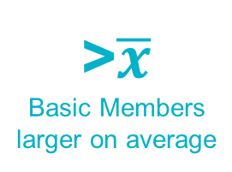
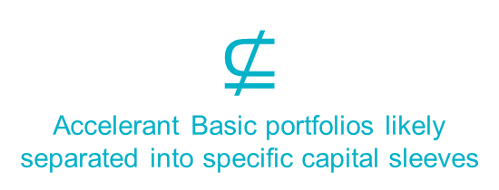
Audacious Aspiration – Accelerant Basic
Appetite expansion (via 3rd party paper) should lead to $3.6B of incremental premium in 2029
Assumptions
Accelerant Basic
8%
Risk exchange
fee
4%
Risk exchange
fee
+8
New Basic Members per year
>$\overline{x}$
Basic Members larger on average
1 + 1 = 3
Accelerant Basic products lead to Member gains in other products
$$⊈$$
Accelerant Basic portfolios likely separated into specific capital sleeves
# of Members
215 | 278 | 346 | 414 | 484 | 553
1

Slide 55

Audacious Aspiration – Captives (via Velox Re)
+26 new Captive Members + 8 existing Member captives a year leads to $2.5B of premium in 2029
Assumptions
Captives
+26
New captive Members per year
131
Captive Members by 2029
+8
Existing Member captives per year
40
Members with captives by 2029
7.7%
Risk exchange & MGA Ops fee
3.8%
Acc. Underwriting from Spec/Agg
Synthetic captives sit within non-consolidated unrated Puerto Rican reinsurer, Velox Re
# of Members
215 | 297 | 385 | 477 | 578 | 684
1

Slide 56
Audacious Aspiration – Lloyd’s
$1.0B of 2029 incremental premium from geographic expansion, treaty MGAs, and Lloyd’s partnerships
Assumptions
Lloyd’s (Incremental)
+2
Incremental new Members per year
+10
New Members
by 2029
Dec’24
BOC recommends approval
Apr’25
Permission to start underwriting
All
This is just incremental premium we otherwise wouldn’t write vs. all Lloyd’s
+2
Regions: LatAm & Australasia
$1B
Existing Members write w/ Lloyd’s
# of Members
215 | 299 | 389 | 483 | 586 | 694
1

Slide 57


Audacious Aspiration – Hummingbird & WoodStar
$500M from Hummingbird M&A and $500M from WoodStar M&A = $1.0B of 2029 incremental premium
Assumptions
Hummingbird & WoodStar
Hummingbird
+2-3
New MGAs acquired per year
+500M
Incremental premium in 2029
+2
$100M+ ins. co. WoodStar acq.’s
+500M
Incremental premium in 2027
# of Members
215 | 300 | 391 | 489 | 594 | 704
1

Slide 58
Audacious Aspiration – Accelerant Product Marketplace (fka Digital Distribution)
+400M of incremental premium in 2029 from added distribution for pre-existing Members
Assumptions
Additional Organic Growth
0
Incremental new Members per year
+$400M
Incremental 2029 premium from new distribution opportunities for Members
3-5+ %-point margin upside
Potential to create a win-win-win for Members, Retailers, and Accelerant by creating a more direct connection (and sharing the improved economics)
# of Members
215 | 300 | 391 | 489 | 594 | 704
1

Slide 59
Audacious Aspiration – Premium Build Conclusion
An immense amount to tackle, but not completely untenable
2029 Assumptions
Audacious Aspiration
+72
New non-captive Members per year
~25
Risk Exchange Insurers in total
Design thoughts
By using parallelism and adding one layer of richness at a time, the series makes its point more effectively
+26
New captive Members per year
10M
Active policies in force
1B+
Rows of data ingested via Gen2
+30M
Rows of data ingested monthly
10k+
Non-NDA active contracts/SOWs
80+
Insurance regulators
# of Members
215 | 300 | 391 | 489 | 594 | 704
1

